Slide 1



Bookscape
a recommendation engine for your digital library, right at your fingertips
Computational Thinking
‹#›

Slide 2


Facultatea de Matematică și Informatică
Universitatea Babeș-Bolyai
Team’s members and their affiliation (section)
Humă Niculina
Săsăran Tania
Turcu Mihnea
Data Science Section
1/26/2026
2

Slide 3
Facultatea de Matematică și Informatică
Universitatea Babeș-Bolyai
Motivation
The project was inspired by a common challenge faced by readers: choosing the next book to read. We also wanted to see an overview and gain an insight on the last 10 years’ books. By combining data analysis with an interactive interface, the application aims to support discovery and decision-making in a structured and engaging way.
This topic is relevant both personally and academically. On a personal level, it aligns with an interest in reading and literature. Academically, it provides a practical context for applying data analysis, visualization, and machine learning techniques to a real-world dataset, demonstrating how large-scale data can be transformed into meaningful insights.
1/26/2026
3

Slide 4
Facultatea de Matematică și Informatică
Universitatea Babeș-Bolyai
The main features of the project
The application is built around a large-scale book dataset and provides functionalities such as sorting, filtering, searching, statistical analysis, visualizations, computational methods and machine learning techniques.
The project is implemented in four iterations, each expanding the scope and complexity of the system:
Simple MVP
Improved frontend and chose a better dataset
Statistical insights and adjustable plots
Recommendation engine and semantic search
1/26/2026
4

Slide 5

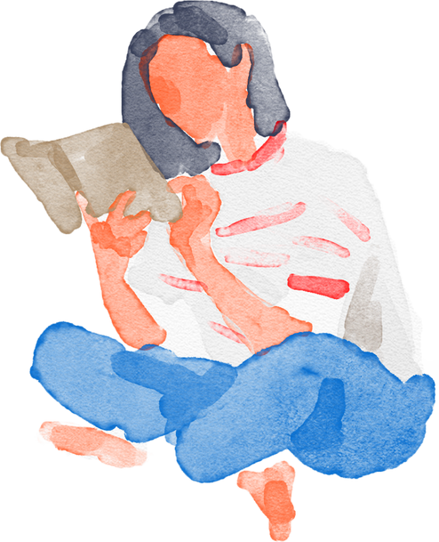

Facultatea de Matematică și Informatică
Universitatea Babeș-Bolyai
Project Description
This is a library app project with thousands of books that allows sorting, filtering, searching, as well as computational methods, plots and statistics, recommandation engine and semantic search.
1/26/2026
5

Slide 6

Facultatea de Matematică și Informatică
Universitatea Babeș-Bolyai
Iteration 1: MVP
Developed small-scale prototype using Streamlit, based on a mock library consisting of 15 books. We defined the main entity of the project, Book, with attributes like title, author, genre, and publication year, and implemented basic operations for managing the collection of entities. These operations include searching, filtering, and sorting the list of books, facilitating the interaction with the dataset.
1/26/2026
6

Slide 7
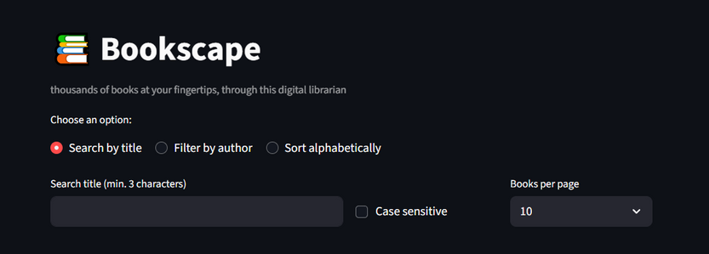
Facultatea de Matematică și Informatică
Universitatea Babeș-Bolyai
Iteration 2: New Dataset and Cleaning
The dataset was replaced with a larger and more comprehensive one, better suited to support the project’s extended functionalities. The updated dataset is provided in CSV format and contains 52,478 books with 25 attributes each. The data was collected from Goodreads using a web scraper, and both the dataset and the scraper’s source code are publicly available here.
Additionally, the application’s design and functionality was enhanced through improved layout, alignment, the inclusion of images, targeted searching and filtering, refined and paginated sorting.
1/26/2026
7

Slide 8
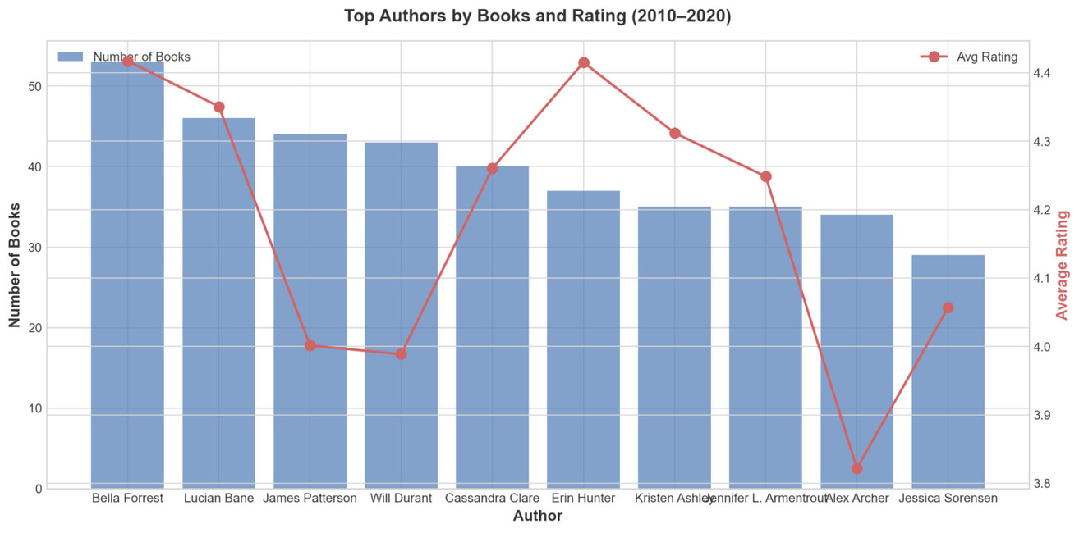

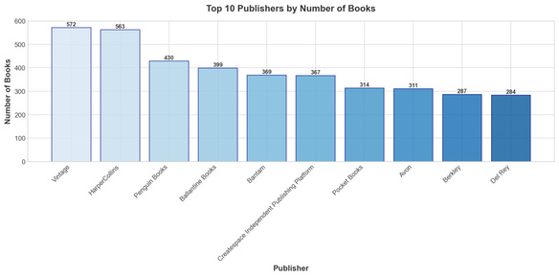
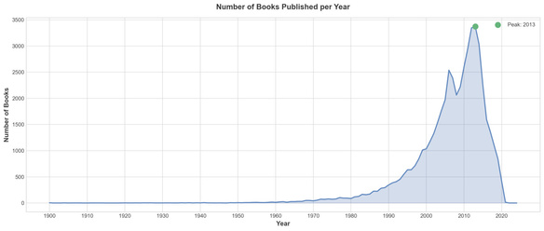
Facultatea de Matematică și Informatică
Universitatea Babeș-Bolyai
Iteration 3: Visual Insights
Extended the core features by adding visual insights and filtering tools:
Top Authors (2010–2020) : bar + line chart with book count and average rating.
Top Publishers: shows top 10 publishers by number of books.
Books per Year : (1900–2024), grouped by decades, with year filtering and highlight of most/least active years.
1/26/2026
8

Slide 9


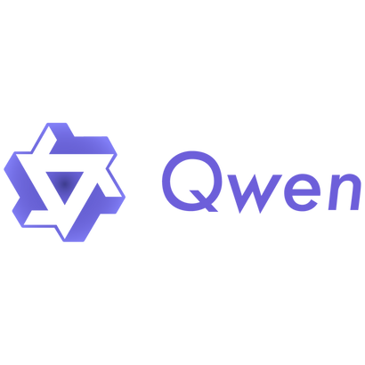

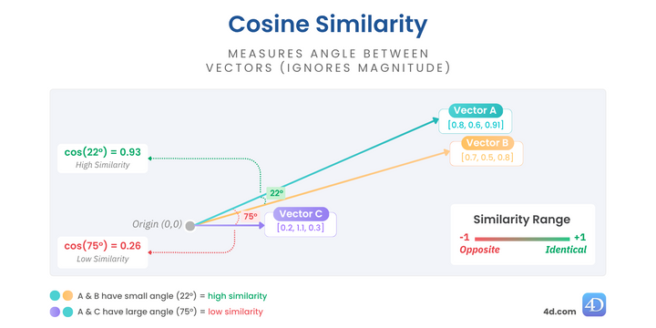
Facultatea de Matematică și Informatică
Universitatea Babeș-Bolyai
Iteration 4: AI-powered recommendations and semantic search
FAISS for the Vectore store and Cossine Similarity
Cached embeddings for Performance and Scalability
Persistent settings UI + json Config file
Multiple Embedding Model providers:
local models
HuggingFace API: MiniLM, Gemma-300m, Qwen-0.6b, Qwen-8b
LMStudio Server:
OpenAI format: e.g ChatGpt, Google’s Gemini, Claude
Cross Platform: runs on Apple Silicon, on Nvidia Cuda aswell as on CPU
1/26/2026
9

Slide 10

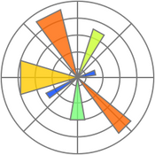

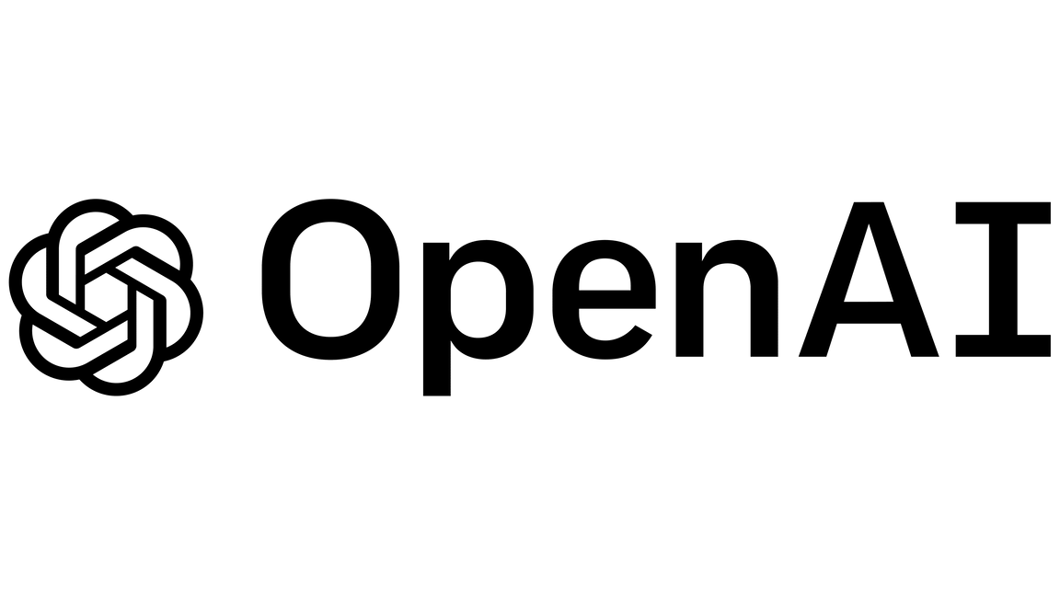



Facultatea de Matematică și Informatică
Universitatea Babeș-Bolyai
Technologies stack
Frontend/UI: Streamlit
Data Processing: Pandas, NumPy
Visualization: Matplotlib
ML/AI: LangChain, Sentence-Transformers, FAISS (vector store), PyTorch
LLM Providers: Google Gemini, OpenAI, HuggingFace
Language: Python 3
1/26/2026
10

Slide 11

Facultatea de Matematică și Informatică
Universitatea Babeș-Bolyai
Challenges and Solutions
Large dataset size (52k books), so displaying all entries at once was impractical, so pagination was implemented.
Due to many pages and a high number of Arabic titles, a “go to letter” dropdown, page number input, and circular page navigation were added to improve usability.
To avoid repeatedly downloading book covers, local caching of book covers was implemented.
Ratings were displayed using star icons; since half-star emojis are unavailable, ratings were rounded to the nearest integer.
Search was enhanced to support partial matches and to ignore diacritics and special characters in authors' names.
Quotation marks and special symbols in titles were excluded during sorting to maintain logical ordering.
Inconsistent publication year formats (in older and region-specific entries) required custom normalization.
Computing embeddings for all books was computationally expensive, requiring optimized processing and caching.
The application was adapted to run reliably across different OSes and hardware configurations(Apple Silicon Chips, Nvidia Cuda and CPU).
1/26/2026
11

Slide 12
Facultatea de Matematică și Informatică
Universitatea Babeș-Bolyai
Resources used
Best Books Ever (BBE) dataset, published under the CC BY-NC 4.0 license. Lorena Casanova Lozano, & Sergio Costa Planells. (2020). Best Books Ever Dataset (Version 1.0.0) [Data set]. Zenodo. http://doi.org/10.5281/zenodo.4265096
Streamlit. (2024). Streamlit Documentation. https://docs.streamlit.io/
Pandas Development Team. (2024). pandas: Python Data Analysis Library. https://pandas.pydata.org/
Hunter, J. D. (2007). Matplotlib: A 2D Graphics Environment. https://matplotlib.org/
PyTorch Team. (2024). PyTorch Documentation. https://pytorch.org/docs/
Machine Learning & Embeddings:
Reimers, N., & Gurevych, I. (2019). Sentence-BERT: Sentence Embeddings using Siamese BERT-Networks. https://www.sbert.net/
HuggingFace. (2024). all-MiniLM-L6-v2 Model. https://huggingface.co/sentence-transformers/all-MiniLM-L6-v2
BAAI. (2024). BGE Embedding Models. https://huggingface.co/BAAI/bge-small-en-v1.5
Alibaba. (2024). GTE-Qwen2-1.5B-instruct Embedding Model. https://huggingface.co/Alibaba-NLP/gte-Qwen2-1.5B-instruct
Johnson, J., Douze, M., & Jégou, H. (2019). FAISS: A Library for Efficient Similarity Search. https://github.com/facebookresearch/faiss
LangChain. (2024). LangChain Documentation. https://python.langchain.com/
Google. (2024). Gemini API Documentation. https://ai.google.dev/docs
OpenAI. (2024). OpenAI API Documentation. https://platform.openai.com/docs
OpenAI. (2024). OpenAI Embeddings Guide. https://platform.openai.com/docs/guides/embeddings
1/26/2026
12

Slide 13
Facultatea de Matematică și Informatică
Universitatea Babeș-Bolyai
Future development plan
User Personalization - Add user accounts with reading history, favorites, and personalized recommendations based on past interactions
Enhanced Search - Implement fuzzy search, filters by genre/year/rating, and advanced query options (e.g., "books like X but shorter")
Social Features - Reading lists, book reviews, ratings from users, and "readers also liked" suggestions
RAG Integration - Use LLM + retrieval to answer natural language questions about books ("What's a good mystery set in Victorian England?")
Performance - Optimize embedding generation, add caching layers, and support larger book catalogs
1/26/2026
13

Slide 14
Facultatea de Matematică și Informatică
Universitatea Babeș-Bolyai
Questions?
1/26/2026
14

